Slide 1
Traffic Analysis for Denver County
By: Myra Rust

Slide 2
Data Overview
1 year of data: July 2020 – June 2021
Total observations: 17,203
67.3% of collisions occur during daylight hours
84.2% of collisions occur during dry conditions

Slide 3
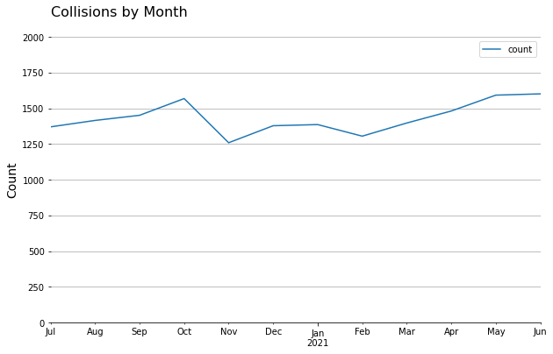
Monthly Fluctuation of Collisions
Very little fluctuation observed from month to month.
Only 350 total fluctuation from min to max.

Slide 4
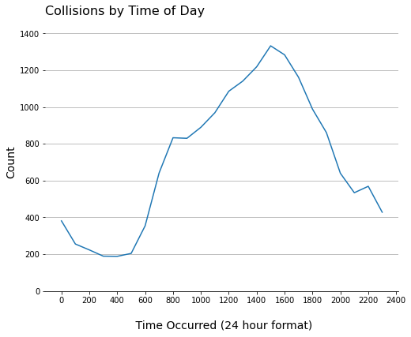
Daily Collision Pattern:
Sharply increasing from ~5am to ~8am
Stagnant from ~8am to ~930am
Generally increasing from ~930am to ~3pm
Generally decreasing from ~3pm to ~2am
At their daily minimum at ~230am to ~5am
At their daily maximum at ~3pm

Slide 5
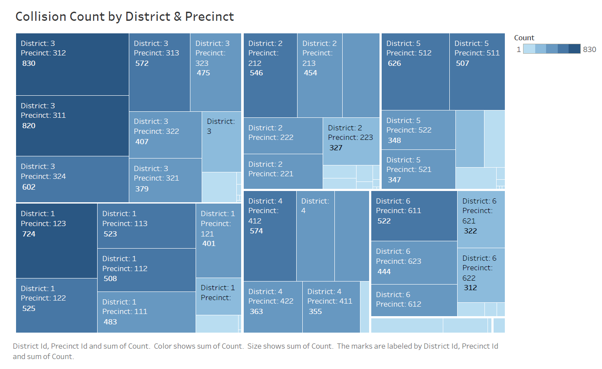
Collisions by District & Precinct

Slide 6
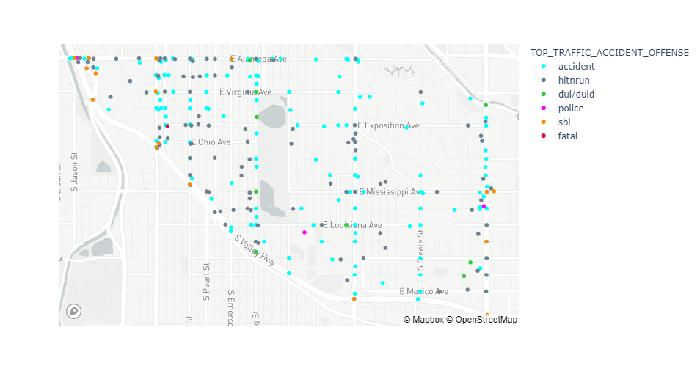
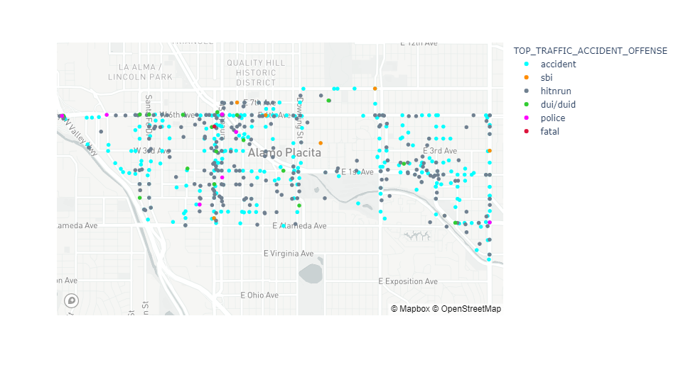
Precincts With Most Collisions
311
312

Slide 7
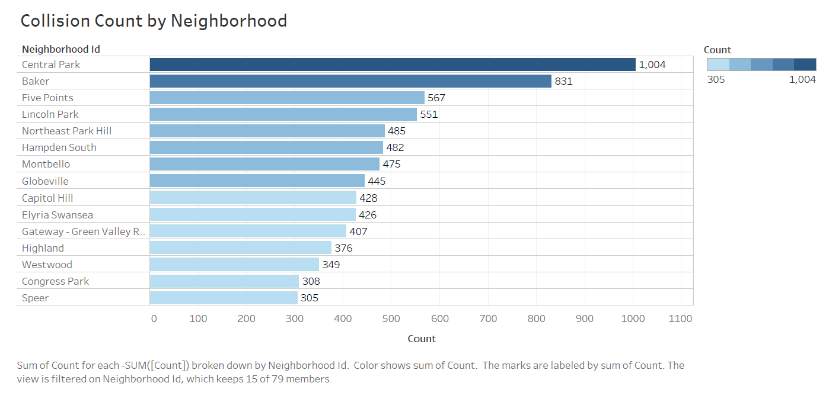
15 Neighborhoods With Most Collisions

Slide 8
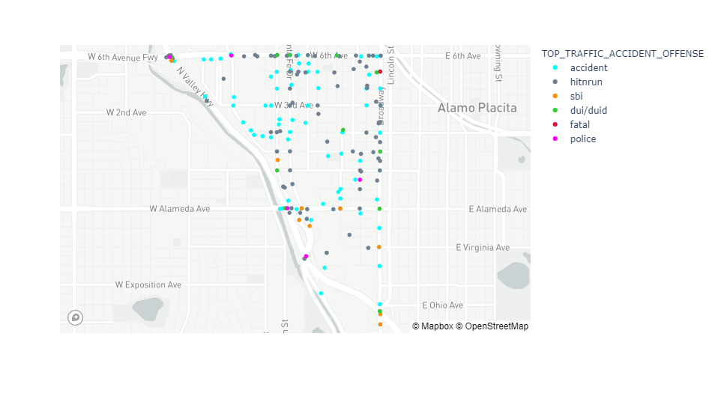
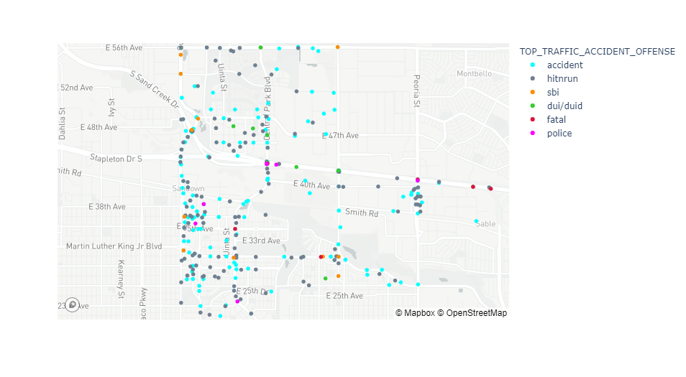
Neighborhoods With Most Collisions
Central Park
Baker

Slide 9
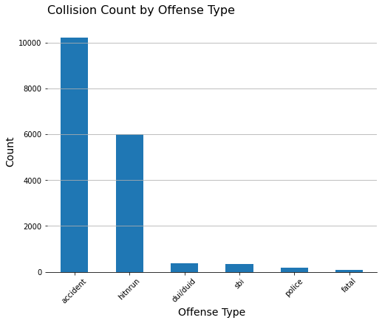
Types of Collisions
Offense Type | Percentage of Collisions
Accident | 59.5%
Hit and Run | 34.8%
DUI/DUID | 2.2%
SBI | 2.0%
Police | 1.1%
Fatal | 0.4%

Slide 10
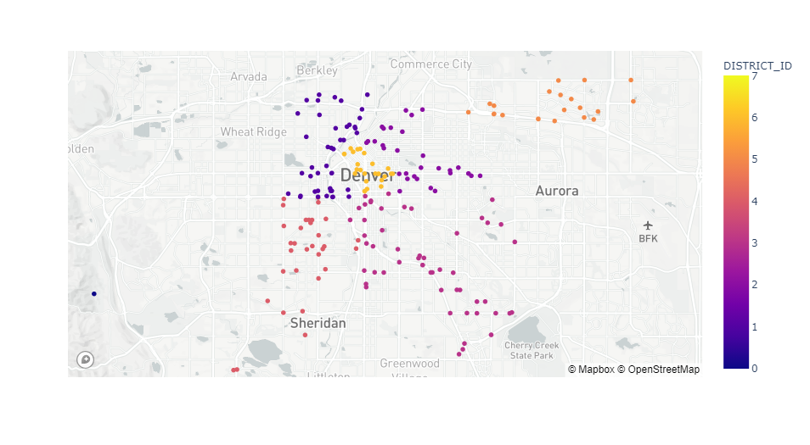
DUI/DUID Collision Locations

Slide 11
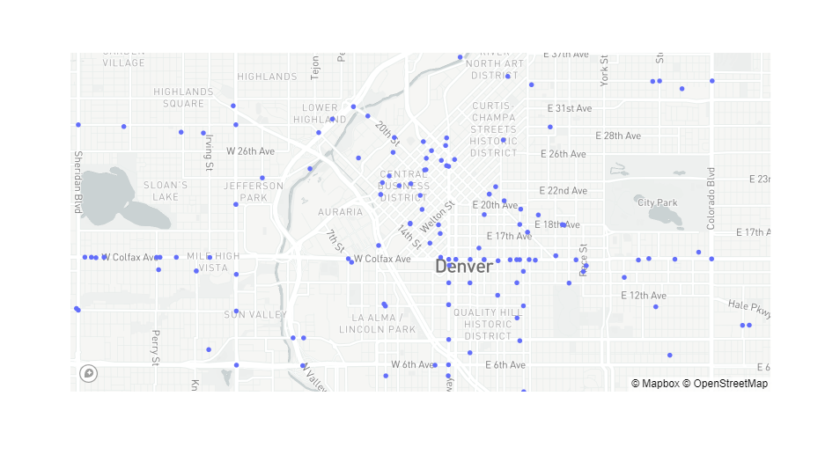
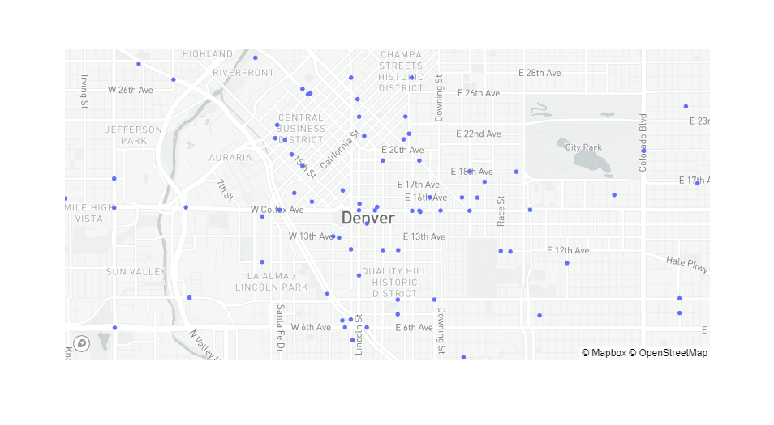
Collisions Involving Pedestrian or Bicycle
Pedestrian
Bicycle
The majority of these collisions occur near downtown

